Slide 1
Web and mobile app development – csc3054/7054
5.3 SQLite database

Slide 2
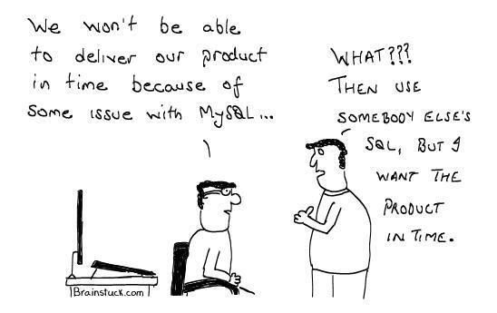

Slide 3
What we discussed in the last lecture?
Options for data storage
Internal storage

Slide 4
Questions to be answered
What is SQLite?
What packages, classes or methods are used in the SQLite architecture?
DAO is used to create a database project. What is it? Why use it?
How is a SQLite project made up?
How many classes/objects are used to serve the database? What are their roles?
How each of the Java classes is built?

Slide 5
Content outline
About SQLite
SQLite architecture
Create a project
Summary
Next lecture
Further readings

Slide 6
About sqlite
SQLite is an open source database.
SQLite supports standard relational database features such as SQL syntax and statements.
The database only requires very limited memory at runtime (~250 Kbyte).
SQLite website: http://www.sqlite.org.
Relational model: was invented by Edgar Codd of IBM, and represents data in relations/tuples.

Slide 7
Sqlite in android
SQLite is embedded in every Android device so does not require a set-up procedure or admin of the database.
One only needs to define SQLite statements for creating and updating the database.
If an Android application creates a database, then it is located at: DATA/data/APP_NAME/database/FILENAME
DATA – the path which the Environment.getDataDirect() method returns.
APP_NAME – application name.
FILENAME – the name of the database.

Slide 8
Content outline
About SQLite
SQLite architecture
Create a project
Summary
Next lecture
Further readings

Slide 9
Sqlite architecture
Packages:
The android.database package that contains all necessary database classes.
The android.database.sqlite package contains the SQLite specific classes.
Creating and updating database:
Create a subclass of the SQLiteOpenHelper class.
In the constructor of the subclass, call the super() method of SQLiteOpenHelper, specifying the database name and the current database version.

Slide 10
Sqlite architecture
SQLiteDatabase: the base class to provide insert(), update() and delete() methods -
rawQuery()
Cursor cursor = getReadableDatabase(). rawQuery("select * from todo where _id = ?", new String[] { id });
query()
return database.query(DATABASE_TABLE, new String[] { KEY_ROWID, KEY_CATEGORY, KEY_SUMMARY, KEY_DESCRIPTION }, null, null, null, null, null);

Slide 11
Sqlite architecture
Cursor: a query returns a Cursor object. The result of a query points to one row of the query result.
ListViews/ListActivities/SimpleCursorAdapter classes:
ListViews: those Views that allow us to display elements.
ListActivities: activities which make ListViews to be used easier.
The SimpleCursorAdapter class used to set a layout for ListViews.

Slide 12
Content outline
About SQLite
SQLite architecture
Create a project
Summary
Next lecture
Further readings

Slide 13
Data access object
Use a data access object (DAO) to manage the data for us.
The DAO is responsible for handling the database connection and for accessing and modifying the data.
DAO will also convert the database objects into real Java Objects so that our user interface code does not have to deal with the persistence layer (a group of files to communicate between the application and database).

Slide 14
Example: relate entities to employees using two different ways
public class Employee {
private int id;
private String name;
public int getId() {
return id;
}
public void setId(int id) {
this.id = id;
}
public String getName() { return name;
}
public void setName(String name) {
this.name = name; }
}
interface EmployeeDAO {
List<Employee> findAll();
List<Employee> findById();
List<Employee> findByName();
boolean insertEmployee(Employee employee);
boolean updateEmployee(Employee employee);
boolean deleteEmployee(Employee employee);
}

Slide 15
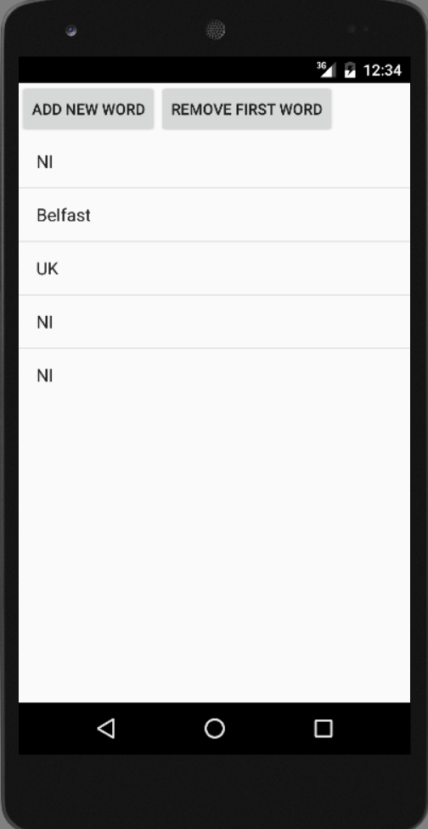
Demo
The resulting application will look like this:

Slide 16
design
MySQLiteHelper.java
To create a table for the database.
Comment.java
To create a data model to hold the data and show in the user interface.
CommentsDataSource.java
To maintain the database and add/fetch comments.
MainActivity.java
To use a ListActivity/ListView to display the data.
To connect to data source.
To show a list of items.

Slide 17
Mysqlitehelper class
This class is responsible for creating the database.
The onUpgrade() method deletes all the exiting data and re-create the table. It defines constants for the table name and columns.

Slide 18
Define variables
public static final String TABLE_COMMENTS = "comments";
public static final String COLUMN_ID = "_id";
public static final String COLUMN_COMMENT = "comment";
private static final String DATABASE_NAME = "commments.db";
private static final int DATABASE_VERSION = 1;

Slide 19
Create database
// Database creation sql statement
private static final String DATABASE_CREATE = "create table "
+ TABLE_COMMENTS + "(" + COLUMN_ID
+ " integer primary key autoincrement, " + COLUMN_COMMENT
+ " text not null);";

Slide 20
Onupgrade() method
public void onUpgrade(SQLiteDatabase db, int oldVersion, int newVersion) {
Log.w(MySQLiteHelper.class.getName(),
"Upgrading database from version " + oldVersion + " to "
+ newVersion + ", which will destroy all old data");
db.execSQL("DROP TABLE IF EXISTS " + TABLE_COMMENTS);
onCreate(db);
}

Slide 21
Code explanations
Lines 2-4: constants printing.
Line 5: called to execute the table and create statements on the application’s SQLite database.

Slide 22
Comment class
This class is the model that contains the data that people will save in the database and show in the user interface.

Slide 23
Comment class
public class Comment {
private long id;
private String comment;
public long getId() {
return id; }
public void setId(long id) {
this.id = id; }
public String getComment() {
return comment; }
public void setComment(String comment) {
this.comment = comment; }
// Will be used by the ArrayAdapter in the ListView
@Override
public String toString() {
return comment; }
}

Slide 24
Content outline
About SQLite
SQLite architecture
Create a project
Summary
Next lecture
Further readings

Slide 25
Summary
SQLite basics.
Architecture of SQLite.
Started creating a project of SQLite.

Slide 26
Content outline
About SQLite
SQLite architecture
Create a project
Summary
Next lecture
Further readings

Slide 27
next lecture
To carry on the introduction of creating SQLite database.

Slide 28
Content outline
About SQLite
SQLite architecture
Create a project
Summary
Next lecture
Further readings

Slide 29
Further readings
http://developer.android.com/training/index.html
Android Application Development for Dummies, Donn Felker, Wiley Publishing, Inc., NJ, 2011.

